Slide 1

Growing Relationships
Implementing Programming for Barriered Youth

Slide 2
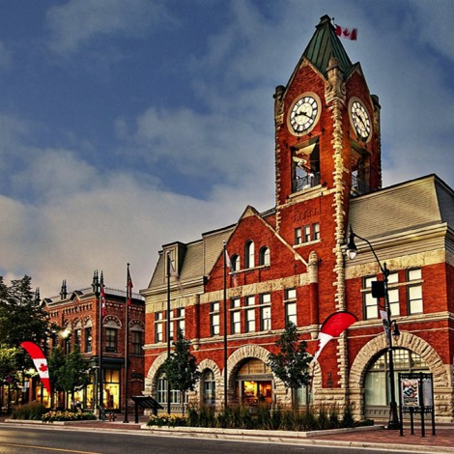

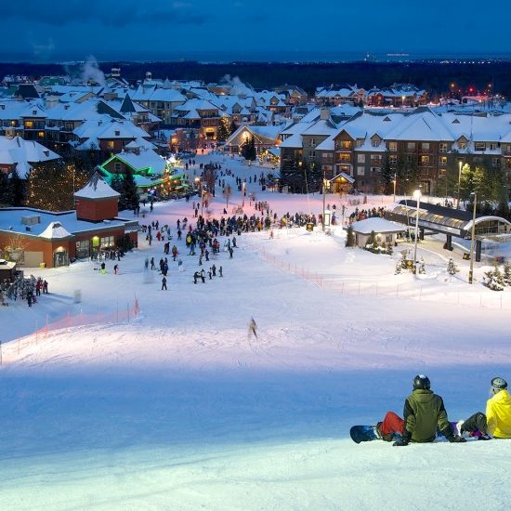
Collingwood
Below the Surface…
Notes:
People mostly know Collingwood as a vacation destination and a beautiful and picturesque and historic town. These things are true. We are a four season tourist destination and we do have a rich history that has been well preserved, but there is much more to the story than meets the eye.
How many people have been to Collingwood before?
Collingwood is a small town had a large segment of our population has social needs. The challenge is that our community has minimal services to meet those needs. And the services that are offered are stretched, because they are the only few that are available.
Our most common social issues that we see in our community as a whole (not just among teens) are:
Poverty – there is a huge disparity between “have and have nots” and that gap is only increasing as Collingwood becomes a more and more popular retirement community and a place for people from GTA to raise their families.
Homelessness – As people from the GTA move up (increased demand for houses), the cost of housing has risen at a great speed. This includes both single family homes and rentals.
Mental Health Challenges - We see this constantly at the library because there is nowhere else for people to go, spend time and interact with other people.
There are significant issues in Collingwood that most wouldn’t notice at first glance. Many locals don’t even realize, and certainly not visitor or new comers to our community.

Slide 3




Population: 19,241
15 – 24 years: 2,314 ; ~11%
40% of Collingwood’s population has no education beyond high school
74% high school graduation rate
Median family income: $78,121
19.4% of children in Simcoe County classified as
low-income
Average cost of single family home: $544,554
Collingwood had a 0.7% vacancy rate
2200 emergency shelter visits in 2015;
30% of visits were individuals aged 16 to 24
Notes:
Population: 15 – 24 years: 2,314 ; ~11%
Education: 40% of Collingwood’s population has high school diploma or equivalent or no diploma, certificate or degree ~from Town of Collingwood Community Profile, 2014
Simcoe County has a steady high school graduation rate of 80% ; our local public high school has a 74% high school graduation rate – 6% below our county average. To compare, TDSB has a high school graduation rate of 84% (2014).
Dollars and Cents: Median family income: $78,121 ; 19.4% of children in Simcoe County classified as low-income. These numbers are concerning when we look at our basic needs, primarily housing and food.
Housing: Average cost of single family home: $544,554 (2016). This number is daunting, especially when you look at our average income. Collingwood has a 0.7% vacancy rate. Our rental space is at a premium because people cannot afford houses. In Simcoe County, there were 2200 emergency shelter visits in 2015; 30% of visits were individuals aged 16 to 24. There is currently no emergency shelter in Collingwood.
When you see these stats, is anyone reminded of their community? Does this reflect anyone else’s experiences?
Jocelyn is going to talk more about our challenges with housing in regards to rentals and shelters, particularly the lack there of.

Slide 4
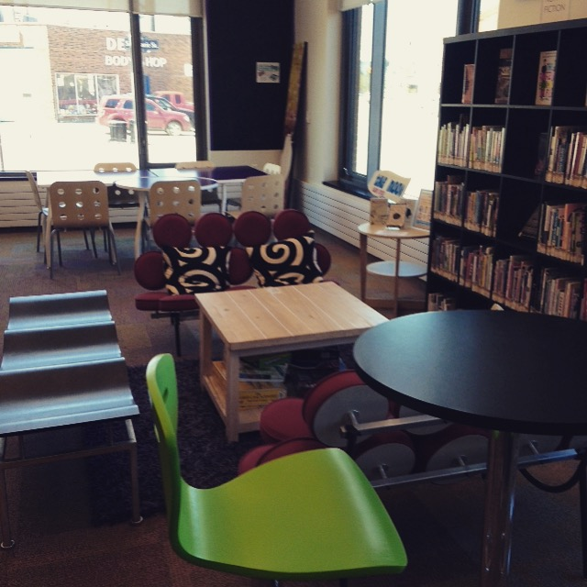
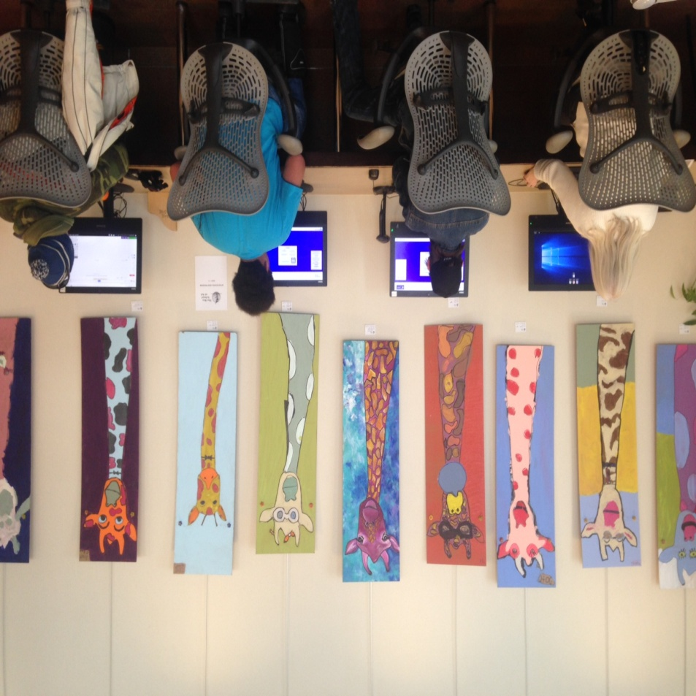
CPL and Teen Services
Notes:
When and why did these youth start accessing the Library?
Library in a central location
Began offering computer access for free (charged $ pre 2014)
Put an emphasis on building relationships with all youth who accessed the space.
As relationships were built, a clearer image emerged of the significant barriers faced by the youth…
Lack of stable housing
Lack of food security
Violence in the home
Lack of positive adult role models
Addictions/mental health issues of caregivers (if any) leading to feelings of instability
Educational challenges
So, what do we see? Youth who are:
Hungry
Homeless or street involved (insecure housing)
Out of school (poor or non-existent literacy skills)
In and out of Jail
pregnant at young ages
What they asked us for:
Food!!!!
Info on shelters and emergency sleeping arrangements
Health info – birth control
Pre and post natal care referrals
Reference letters for court system

Slide 5
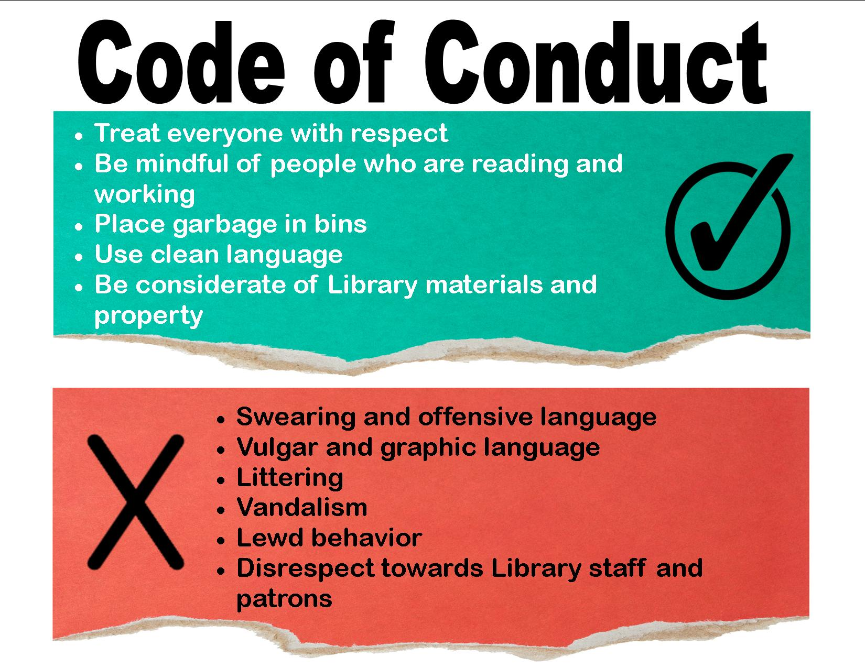
Issues & Challenges
Dealing with Inappropriate Behaviours and Patron
Push-Back
Notes:
So, the youth are at the library using our space, all day every day. Naturally, we’re going to run into some challenges, and it started with behaviour. Some of the common things we saw were:
-making out/flirtatious or sexual touching: we had a couple bean bag chairs, which were too comfortable. We had to remove these from the department in an attempt to control PDA.
-swearing and offensive language: racist, sexist, constant swearing, sexual jokes.
-inappropriate topics for public space – guns, sexually explicit, STIs, drugs/drug use. Their language and conversations were more challenging to address, as we couldn’t always hear what was being said, but perhaps a patron was closer and could hear everything that was being said. It was also challenging because they were often in large groups, so you weren’t always sure who the culprit was. We give out a lot of language warnings and came to the conclusion that after three warning you would be asked to leave for the day.
-occasional minor vandalism: throwing books, slamming into doors.
All of this behaviour was just to test their boundaries and see how much they could get away with, so we had to enforce strict guidelines, both for the youth and for staff to follow. Code of Conduct.
We certainly had a lot of comments and concerns from patrons.
-One issue we faced was staffing the teen department. When Jocelyn was there, they were generally well behaved. However, as soon as there was a lack of supervision, all their best behaviour practices went out the window.
-We certainly received letters and emails from patrons concerning youth using the library and things patrons had overheard. Our CEO usually addressed these queries and assured the public that staff members were aware of the situation and doing their best. The silver lining here was that we were creating awareness of the challenges these youth are facing.

Slide 6
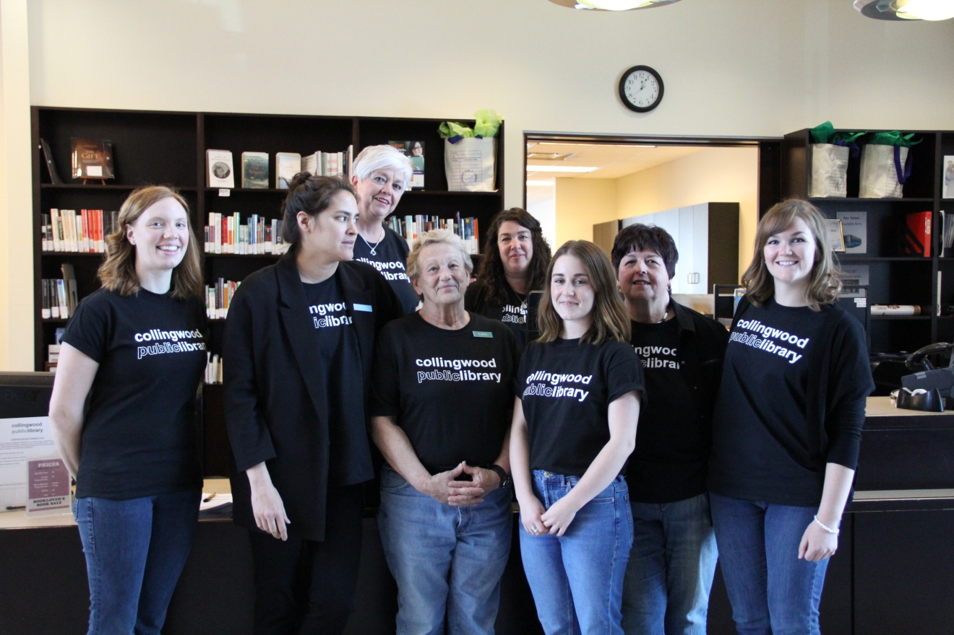
Staff Support
Notes:
Staff Support
Our library (and community) is very lucky to have staff that, for the most part, were on board with finding the best ways to serve the needs of the youth.
It was certainly an uphill battle on some days, as both staff and patrons were becoming frustrated with poor behaviour or complaints. We had to organize a special staff meeting specifically to discuss the challenges we were facing in the teen department. What were our frustrations, what were we hearing from patrons, and what solutions did we have.
To start, we had to ensure that staff understood the challenges that these youth were facing in their day to day lives. We often heard complaints such as “why can’t they just get a job?” Well, because they don’t have their high school diploma or GED, they have a criminal record, they have a curfew, so they can’t work late hours, which eliminates some employment options (fast food, restaurants, etc).
We had to ensure that the teen department was staffed at all hours, or at the very least, that staff had a regular presence through “walk arounds.”
As such, staff needed support and guidance, primarily through training: ASIST, Mental Health First Aid, De-escalation. We want our staff to have the skills to handle the challenges they will face while working in the teen department, but with the public, in general.
We also set out clear behaviour guidelines for the youth, and these were posted in the teen department. Staff were also given guidelines in terms of how many warning to issues before asking someone to leave and the length of time a ban would be issued for based on behaviour. We also have re-admittance agreement that we have youth sign when they return to the library after a ban.
We encourage staff to bring any issues/concerns/problems/ideas to everyone’s attention. At staff meetings it wasn’t unusual to have conversations about how to address issues brought up by other patrons who were concerned about why and how the youth were using the space and what how we were supporting them.

Slide 7

Boundaries & Limitations
Notes:
It was evident that a segment of youth in our community were facing significant barriers. It was also evident that there were few or no services in place to aid them. When there were services, youth were not always accessing them (barriers with transportation, criminal records, etc.) The library staff wanted to help, but we had to acknowledge our own boundaries and limitations to helping youth.
Limitations of Library staff
-our traditional/formal training does not equip us with the tools to aid the youth we were seeing. Even with additional training, at the end of the day, we are not social workers or health care providers, we are librarians.
What can’t we do to help the youth?
-we cannot provide resources for barriered youth if they aren’t available – in our community they were not always available. Youth cannot sleep at the library, staff cannot take them home for the night, we cannot build them a shelter in an hour.
What can we do to make a difference?
-be a voice for youth in our community – we need a short-term emergency shelter – sit on committees
-provide youth with the resources that are available – we can hand out condoms, toothbrush/toothpaste, educational resources for getting their GED.
-youth were at the library, asking for food on a regular basis – with had the resources and space in our own facility to provide them with a healthy meal. Jocelyn is going to talk more about how we worked towards filling this gap.

Slide 8
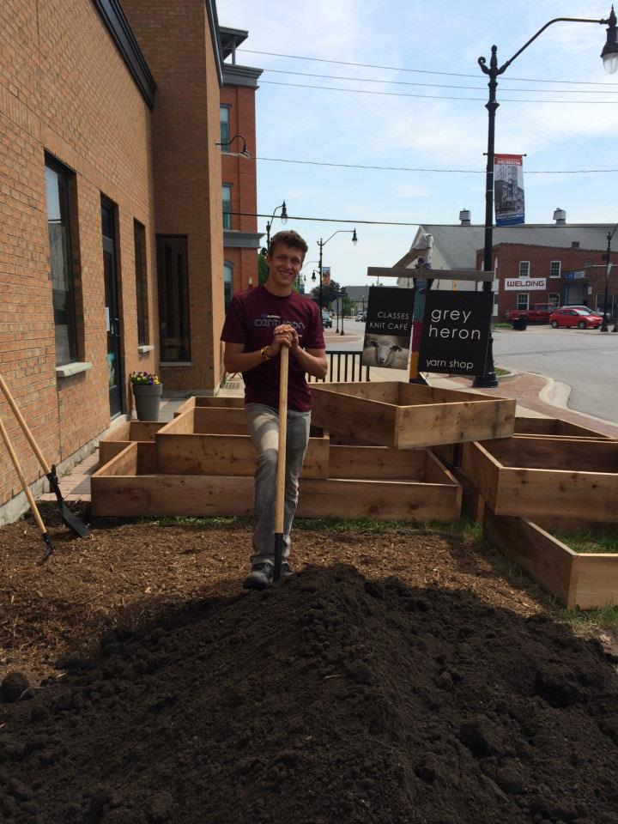
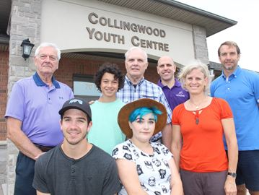
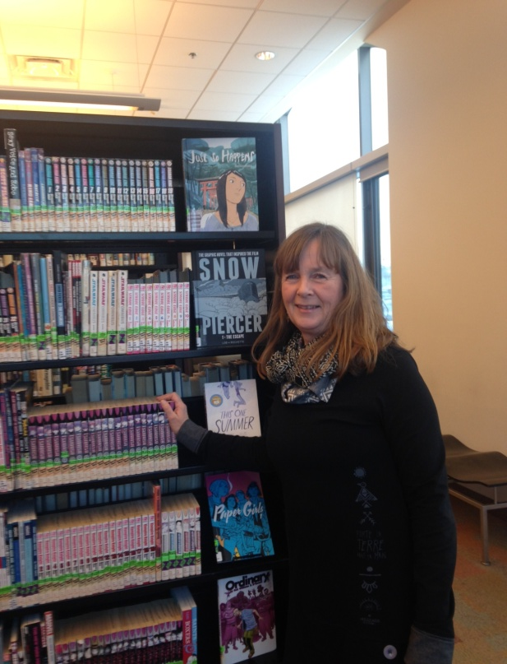
Building Partnerships
Notes:
So there some important things to say at this point…
1.The youth are worth it! Because we’ve gotten to know them and understand their situations we also understand that there are reasons why they act the way they do (lack of +adult role models etc). Boundaries do them good, but it also does them good to know that we are standing with them. We defend their right to be at the library all the time!
2. The boundaries and limitations are actually a lot less than you might think. Doing the work of assisting youth in crisis perhaps seems outside of our scope, and certainly there are community members who wish that the ‘youth problem’ at the library would go away, but overall, our capacity to assist and make positive change is much greater than the limitations and challenges that hold us back.
We built our capacity to help through key community partnerships!
New to Collingwood
Needed to know which org’s already existed:
Who could?:
Provide food (salvation army, community dinners)
Offer emergency shelter (motels, home horizon, women’s shelter)
Provide housing information
Help with job searches
Offer mental health care and counselling (no charge)
Offer free health and sexual health services (health unit)
Donate general personal care items (giant tiger)
Also:
Who was already working with youth?
Is there a crisis line available?
Where can we get info on helping youth get back into school?
It turned out that for a small town there were lots of people who were aware of the issues and there were org’s trying to reach out to this demographic. However, we all agree that there are major gaps to service.
1.Emergency shelter
2.Access to food
3.Insufficient mental health care
All the other orgs found this particular user group of youth difficult to nail down. They didn’t consistently show up to programmes offered. But once everyone knew that the Library had become the place, other service providers were eager to partner with us.
Partnerships key to successful programmes!

Slide 9

Notes:
Born out of the constant requests for food, staff scrounging through their lunch bags. (seriously amazing staff!!)
Thought about keeping it simple and figuring out how to get cans of soup donated.
Approached Health Unit to see about getting approval to use our kitchen to serve food to the public. They came for an inspection and gave us stickers to put up.
Submitted board report for approval to begin (seriously wonderful board!!!)
Went to local grocery stores requesting support (luckily we have 6 stores that have grocery dept’s). Had best luck a Sobey’s!!
Tenuous at first - weren’t sure where food was going to come from week to week, but stuck with it.
Approached the salvation army food bank for support.
Year went by, started to worry about donor burn out.
Church group!!! (library patron who belongs to parish). This is a great first step to gather support as it turns out.
Partnerships key again.
Power of asking!!! Call not letters for first reach out.
Challenges:
Summer slow-down
Youth participation in prep, intentions to mentor in the kitchen. This hasn’t worked out the way we hoped.
Picky eaters
Successes:
Great opportunity for other service providers to attend and provide info!
Youth showing more respect and being helpful with clean up.
Sitting down and eating together provides more opportunity for talking and finding out about needs. Builds trust too!

Slide 10
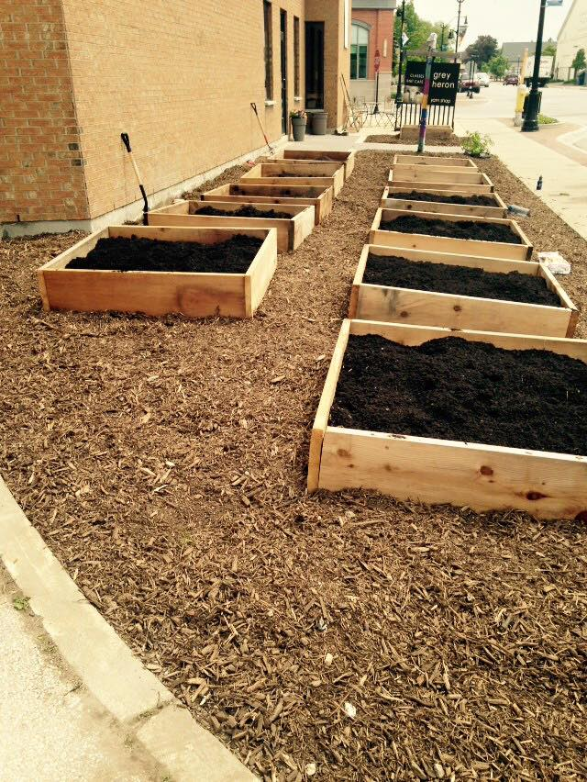
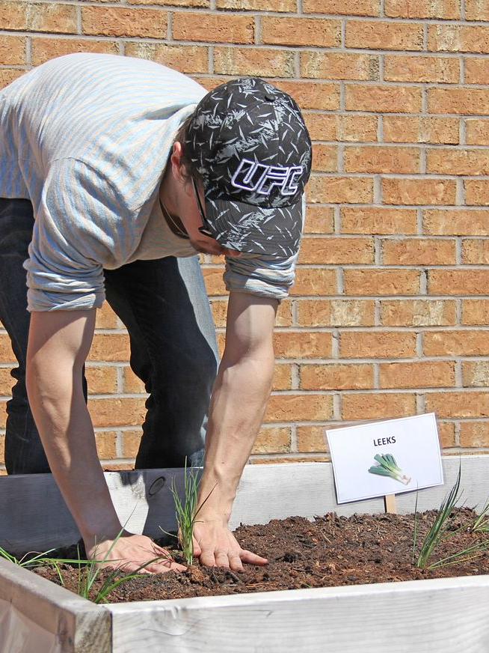
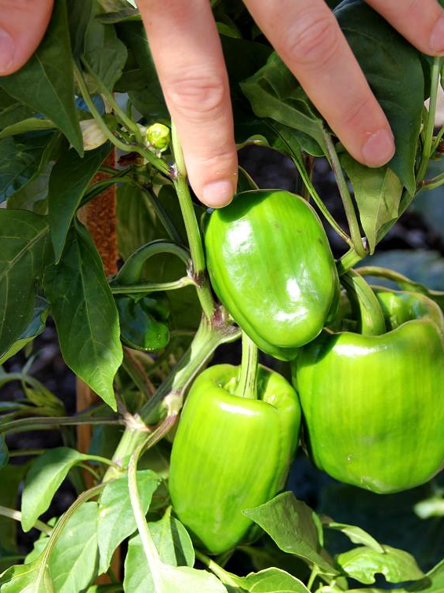
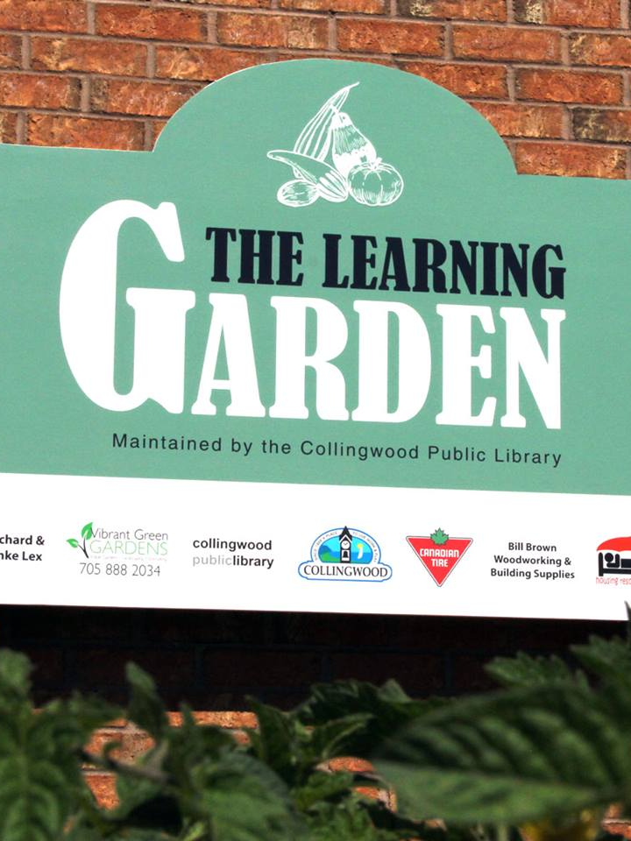
The Garden
Notes:
Initially approached by local youth entrepreneur Michael Burgess who started his own landscaping business. Had a dream of starting a community garden at the Library and wanted to help us make it a reality.
Great idea, but no budget. Thought Michael was offering to do it all, but that was not the case. Still liked the idea because we knew it would tie in nicely to the 4 O’clock food programme.
Library has very little outdoor green space. After some discussion our neighbours gave us ongoing access to green space in front of their building!
Had land and gardener, needed wood for raised beds and soil. Plus seeds/seedlings.
No Budget!!! Started to make calls. Talked about food programme, about education for community, about what we might do with the food...
Donations of cedar from local lumber yard
Seeds from Canadian Tire
Compost from Town of Collingwood.
We did it with no budget and complete community buy-in and support!
Large sign to acknowledge community support
People were concerned about:
Vandalism (this has never been a problem)
Stealing of food (We reframe the way people think about this. To us, it isn’t stealing food. If community members want to help themselves to fresh food right from the garden, we are happy for them to do that).

Slide 11

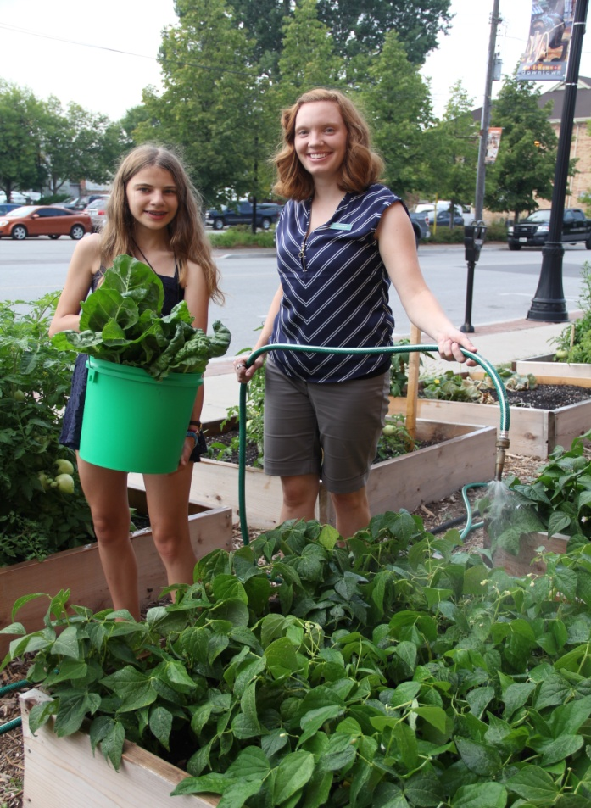
Garden Upkeep
Notes:
Land and water provided by Rick and Anka Lexx, the neighbours who gave us access to their plot of land. They have a tap on the outside of the building that the garden is on, and they let us use the tap to water the garden as often as needed.
Maintaining partnership with Canadian Tire for seeds and seedlings in the spring.
Community planting party in the spring (with significant teen involvement)
Teen Gardening Club through summer - Run it like a regular club, currently no community service hours given for participation, but could be a possibility in the future (administrative requirements for setting up volunteers is cumbersome for us).

Slide 12

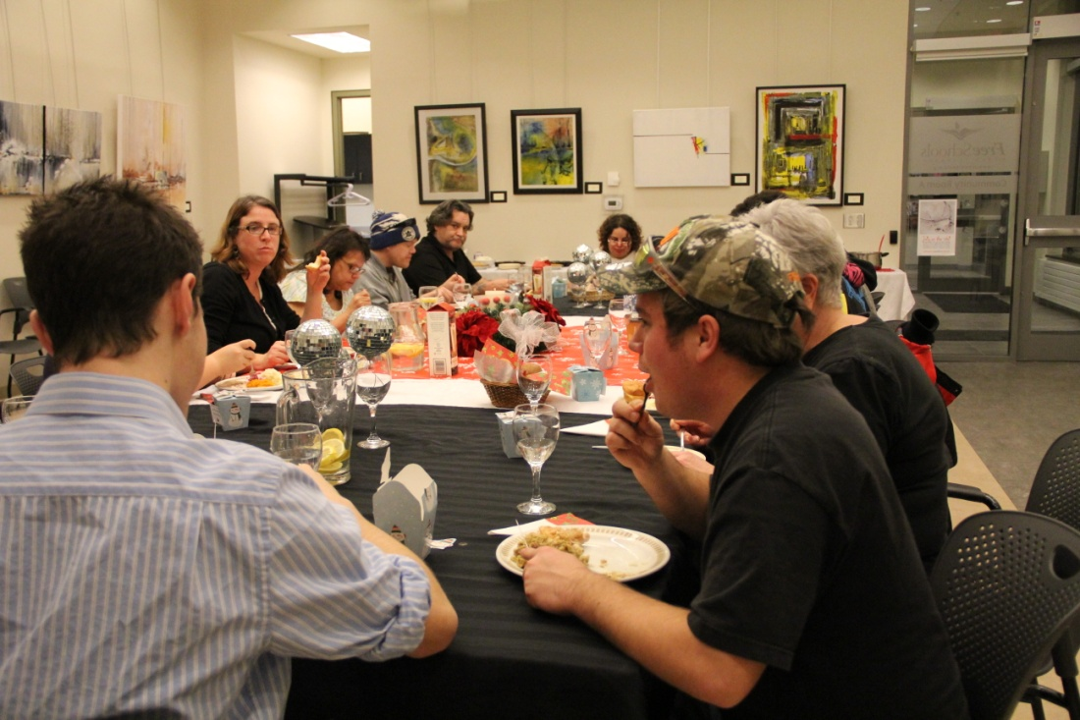
Using the Food We Grow...
Notes:
Goes back into food programme!
Thanksgiving and Christmas feasts with food we grow featured
Canning workshop – all ages welcome. Teens participated. Huge batch of tomato sauce used through the winter for pasta at 4 O’Clock food.
Give food from the garden for free to Library patrons by placing a basket near our entrance that patrons can help themselves from. Contribute to community food security and gives a sense of ease of abundance.
Some excess goes to the food bank.

Slide 13

What does this mean for our community and the youth we serve?
Notes:
Safe space
We’ve put significant emphasis on building trust and it seems to have paid off. Youth are choosing to spend time with us and share their struggles with us. This positions us as helpers and gives us the ability to use our community knowledge and put our partnerships to good use.
Feeding youth one meal per week is not changing their lives, but it helps to meet one small need. More importantly, it helps us to continue to build relationships and trust. Food is an excellent equalizer and eating a meal together gives an important chance to connect on a regular basis.
Eventually we began bringing in guest speakers from other community org’s to provide essential info to the youth. (Tracks, Health Unit, Housing, etc.), we also brought in an artist who made art with them weekly during the food program.
We all know that public libraries are relevant and vibrant spaces, but for us, doing this work has made the Library much more visible in the community and we are approached more often now to act as partners on other key community projects (new youth centre, youth shelter, long table event, etc.).
Some of these things might seem very specific to our community – how these projects came to be. But the message we really want to impart is that if you reach out and build strong partnerships and relationships the obvious ways that work for your library and your community will come to light. Follow the natural progression. That’s what we did and this is where it has taken us.

Slide 14

What’s Next?
Notes:
What’s next?
Very transient – some youth have moved, some have fallen beyond our assistance, some have gone to school. Their needs are always changing and evolving, so our services are always changing and evolving.
Our community is currently planning a new youth centre and library staff sit on the committee for that project. Our community is also planning a new youth shelter, and library staff has been involved in with this project, as well. We are trying to advocate for youth in our community and be a voice for them.
We will continue to provide unique program and learning opportunities:
-community garden
-food program
-speakers and resources at this program
-encourage youth to prepare meals with us
We are also continuously trying to break down barriers between “us and them” mentality. We want to engage these youth with regular and traditional library programming and blend two user groups together – traditional and non-traditional library users. We want to offer programming to all youth in our community.

Slide 16
Contact Information:
Jocelyn Knoester
Coordinator, Volunteer & Technical Services
jknoester@collingwood.ca
705-445-1571 ext. 6231
Ashley Kulchycki
Supervisor, Children & Teen Services
akulchycki@collingwood.ca
705-445-1571 ext. 6234

